Slide 1



RECTANGULAR MICROSTRIP PATCH ANTENNA
GUIDED BY
Dr C NANDAGOPAL., ME.,Ph.D.,
Submitted By
MADHUSRI J 927621BEC109

Slide 2
OBJECTIVES
The main objective is to design and analysis the new electromagnetic band gap of microstrip antenna operating at 5.2GHz frequency for wireless communication.
To enhance the rectangular microstrip patch antenna gain, and bandwidth.

Slide 3
ANTENNA
Antennas are key components of any wireless system .
An antenna is a metallic structure that captures and transmits radio electromagnetic waves.
Antennas play an important role in the operation of all radio equipment.
They are used in wireless local area network, mobile telephone and satellite communication.

Slide 4
SOFTWARE USED
Ansys HFSS.
HFSS - High Frequency Structure Simulator.
HFSS is the one of the several commercial tools used for antenna design, transmission lines and packaging.

Slide 5
DESIGN PROCEDURE
Select the substrate to assign material.
By using the dimension, design the required shape of the antenna.
Assigning boundaries and excitations.
Solution setup.
Analyze the results.

Slide 6
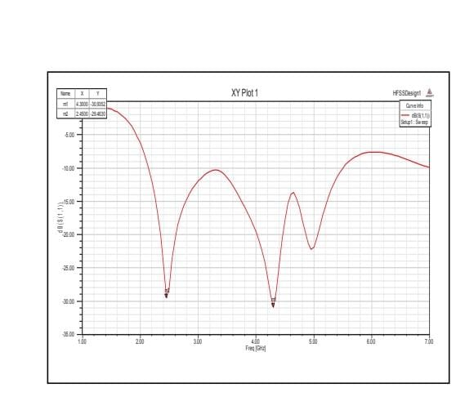
RETURN LOSS

Slide 7
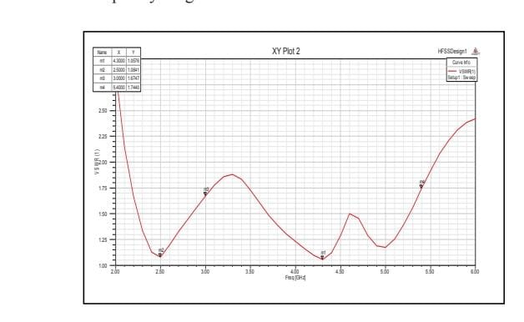
VOLTAGE STANDING WAVE RATIO

Slide 8


